Slide 1
Session 1.1: History
Disinformation/Malign Influence Training
SJ Terp & P Breuer, Threet Consulting | 2021

Slide 2
1.1 History
History
History of information
Cognitive Security as a Business
Disinformation as a service models
Financial motivations and estimates
Business effects of disinformation
Introduces business models behind disinformation and cognitive security. Goes into detail on the potential business attack vectors and effects from disinformation and hybrid campaigns that include disinformation (e.g. hacking, malware etc).
Outcome: students can articulate disinformation business models
Sectors
Cognitive security and business - potential directions
Health sector: medical misinformation trends in Covid19 and Vaccine hesitancy
Elections: trends around the world
Responses: trends around the world
potential future arcs for disinformation incidents and response.

Slide 3
History of information

Slide 4
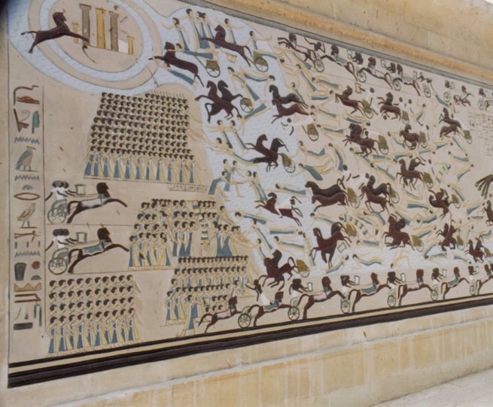
History of information
Propaganda is as old as time

Slide 5
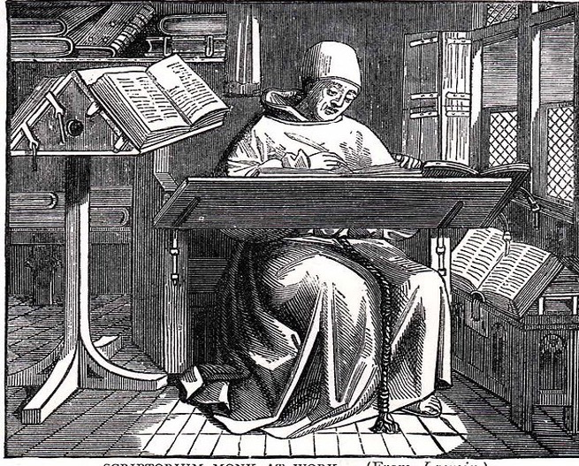
History of information
The written word
Limited signal generation
Limited transmission
Limited ability to receive
Notes:
Until around 1440 CE, if you wanted to transmit a message, the only way to do it was to write it out and carry it. The states and the church would employ monks/friars to hand-copy messages and books and they’d be carried by a person to their destination. Literacy was not common and parchment and ink were expensive. So the creation, transmission, and reception of messages could only be carried out by a select few. Sure, once a message arrived at its destination, a town crier or religious figure could “transmit” the message to anyone within earshot, but addressing a mass audience was difficult, slow, and required significant resources and required specialized knowledge.

Slide 6
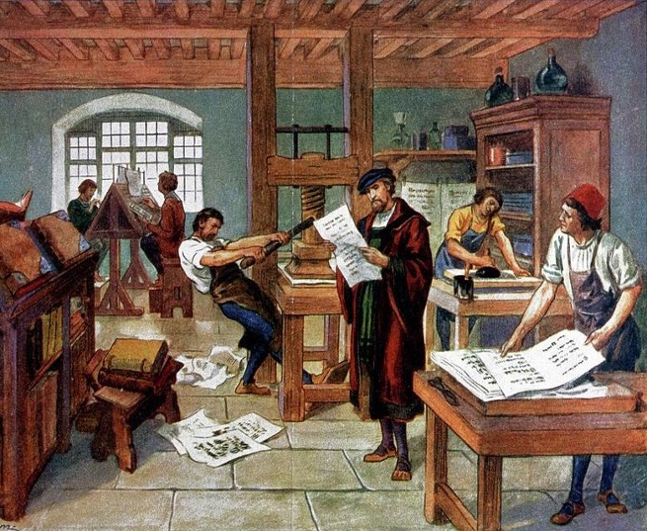
History of information
Movable type
Increased transmission (audience)
Increased reception
Unintended second order effects
Notes:
Fast forward to 1455 and we have the invention of the Guttenberg press and movable type. Creation of an original is still timely and expensive, but once the press is set, reproduction in large numbers becomes much faster. Yes, the “transmission” is still by hand and slow, but now the message can be transmitted to more places because there are more copies. More copies transmitted enable more people to receive the message first-hand and literacy grows.
Here is the first place where we have some “unintended” consequences. The church was a big proponent of the Guttenberg press for printing Bibles. I guess they never thought that Marin Luther would use the same technology to put out “fake news” in the form of his 25 theses and post it all over town.
Paper and ink are expensive as are building and running presses. Literacy slowly becomes more common, but the creation and transmission of messages to the masses is primarily limited to nation-states and the church. Due to the ability to mass produce and increasing literacy, however, the audience for reception grows.

Slide 7
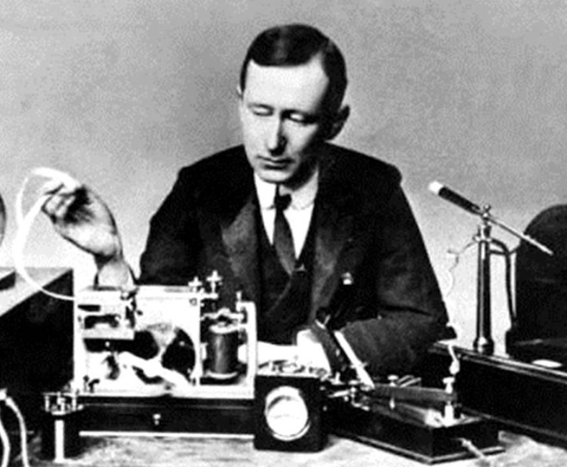
History of information
Telegraph
Increase range
Increase speed
Limited transmission and reception
Radio
Increase range
Increased reception
Limited transmission
Misinformation and disinformation ncidents...
Notes:
In the 1830s we have the invention of the telegraph. Provided that telegraph lines have already been put up, the telegraph allows for messages to be transmitted over large distances, but it’s a point-to-point system. A message is transmitted from one station to another. The receiving station can forward that message to another station, and so on. The building of a telegraph system requires significant resources. Transmission and reception require at least two people that know Morse code and can translate it to common language. Theoretically, anyone can walk into a telegraph office and pay to have a message transmitted, but there needs to be a known recipient at the other end. So the transmission range is greatly increased, but not necessarily the audience size.
In 1895 we have the invention of Marconi’s radio. The invention of the radio is a game change. While there is some amount of knowledge required to tune a radio, once tuned, anyone can transmit a message with the spoken word. Instant communication of information over a relatively wide geographic distance is now possible. Even more important is that anyone within transmission range with a radio is capable of receiving the transmitted information without the need for specialized knowledge. Radios are still relatively expensive, but the price drops drastically.
As the price drops and more have access to the ability to transmit, government realize that this medium must be regulated. In 1910 the US Congress passed the first regulation of radio to restrict the number of stations and physical limitations of those stations. In 1927 further regulation is passed that severely restricts public and private transmission. In 1934 the US starts the Federal Radio Commission and regulation increases. The results of progressive regulation is that the number of people that can transmit is limited as is the range at which they can transmit. This eventually leads to the FCC and parsing of frequencies for various purposes that must be licensed and is therefore back in the control of nation-states.
So the radio enables a much larger audience to be reached almost instantly without the need for specialized knowledge. The audience merely needs to own a simple and relatively inexpensive device and tune in to hear the message. Who can transmit to wide audiences, however, is limited to those that can not only afford a license, but convince the government to afford them a license.
The radio becomes the defacto standard of truth and news. Families gather around the radio for news and entertainment. What could possibly go wrong? In 1938 we find out when “War of the Worlds” is transmitted for entertainment and leads to panic when many of the audience believe they’re listening to news coverage. There’s widespread outrage by the press claiming that the broadcast is deceptive and calling for regulation. I’m really glad we have that solved.

Slide 8
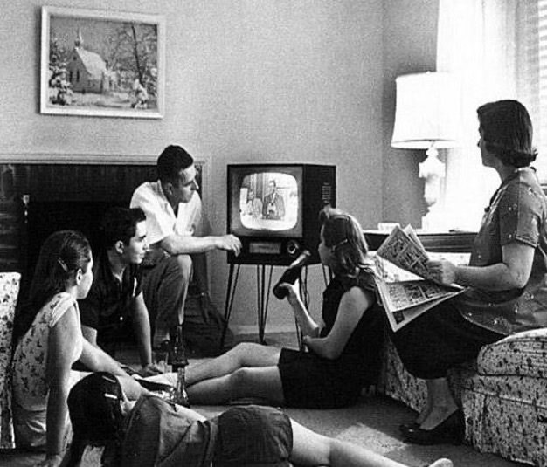
History of information
Television
Increase range
Increase speed
Limited transmission and reception
Disinformation incidents
Notes:
In the 1830s we have the invention of the telegraph. Provided that telegraph lines have already been put up, the telegraph allows for messages to be transmitted over large distances, but it’s a point-to-point system. A message is transmitted from one station to another. The receiving station can forward that message to another station, and so on. The building of a telegraph system requires significant resources. Transmission and reception require at least two people that know Morse code and can translate it to common language. Theoretically, anyone can walk into a telegraph office and pay to have a message transmitted, but there needs to be a known recipient at the other end. So the transmission range is greatly increased, but not necessarily the audience size.
In 1895 we have the invention of Marconi’s radio. The invention of the radio is a game change. While there is some amount of knowledge required to tune a radio, once tuned, anyone can transmit a message with the spoken word. Instant communication of information over a relatively wide geographic distance is now possible. Even more important is that anyone within transmission range with a radio is capable of receiving the transmitted information without the need for specialized knowledge. Radios are still relatively expensive, but the price drops drastically.
As the price drops and more have access to the ability to transmit, government realize that this medium must be regulated. In 1910 the US Congress passed the first regulation of radio to restrict the number of stations and physical limitations of those stations. In 1927 further regulation is passed that severely restricts public and private transmission. In 1934 the US starts the Federal Radio Commission and regulation increases. The results of progressive regulation is that the number of people that can transmit is limited as is the range at which they can transmit. This eventually leads to the FCC and parsing of frequencies for various purposes that must be licensed and is therefore back in the control of nation-states.
So the radio enables a much larger audience to be reached almost instantly without the need for specialized knowledge. The audience merely needs to own a simple and relatively inexpensive device and tune in to hear the message. Who can transmit to wide audiences, however, is limited to those that can not only afford a license, but convince the government to afford them a license.
The radio becomes the defacto standard of truth and news. Families gather around the radio for news and entertainment. What could possibly go wrong? In 1938 we find out when “War of the Worlds” is transmitted for entertainment and leads to panic when many of the audience believe they’re listening to news coverage. There’s widespread outrage by the press claiming that the broadcast is deceptive and calling for regulation. I’m really glad we have that solved.

Slide 9
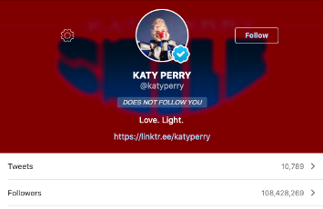
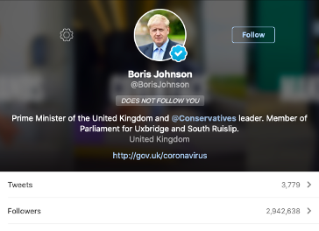
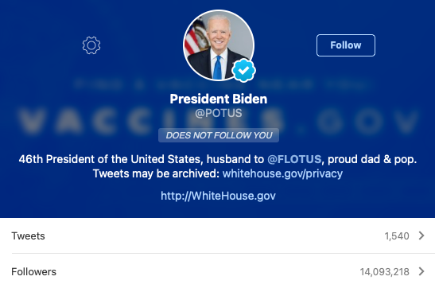
History of information

Slide 10
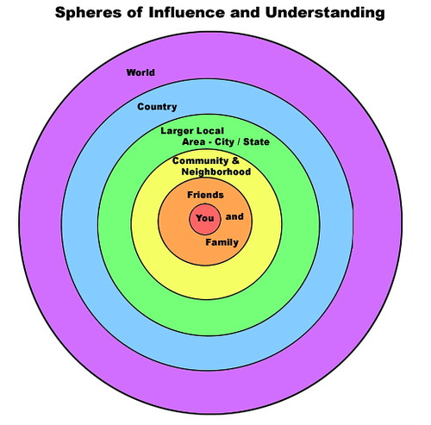
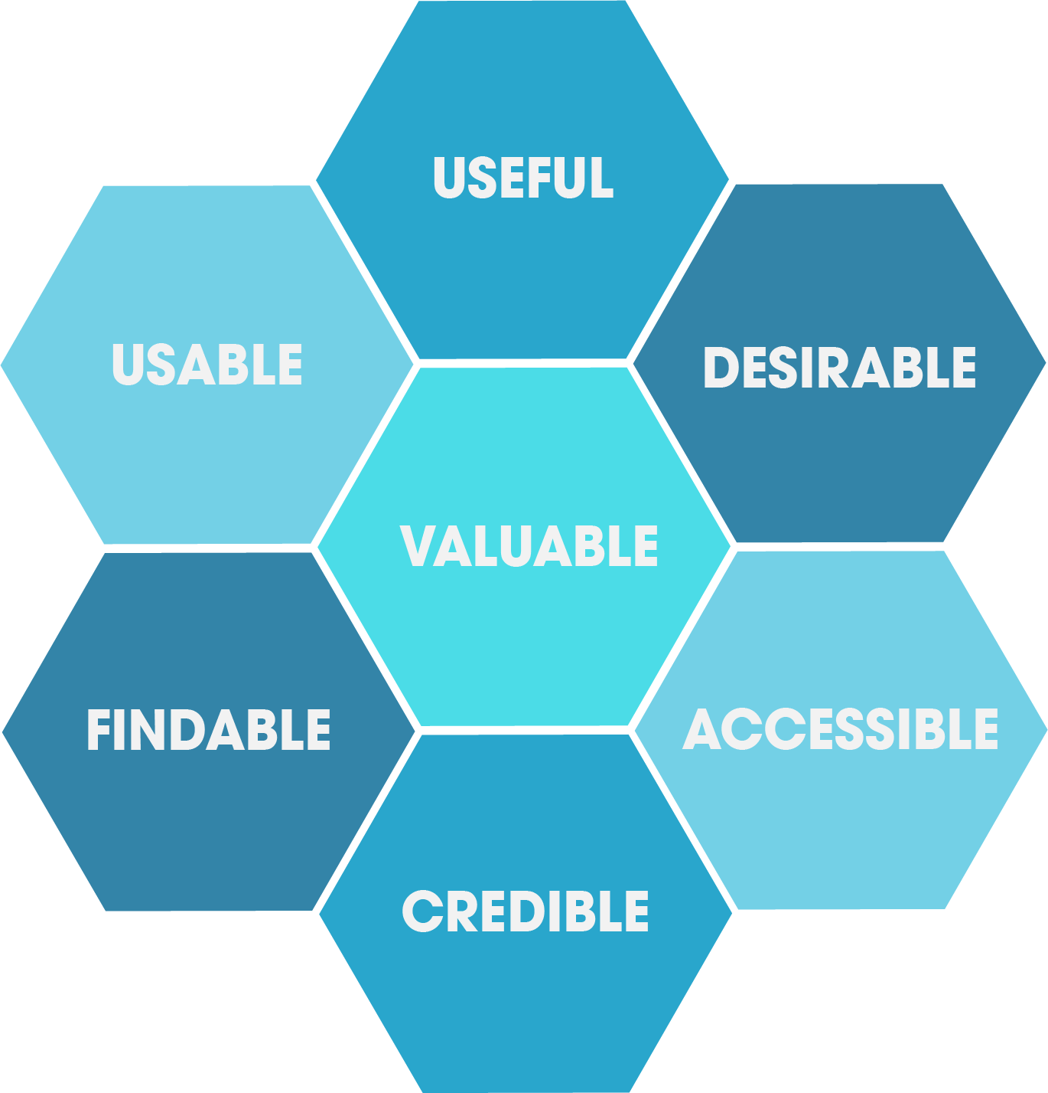
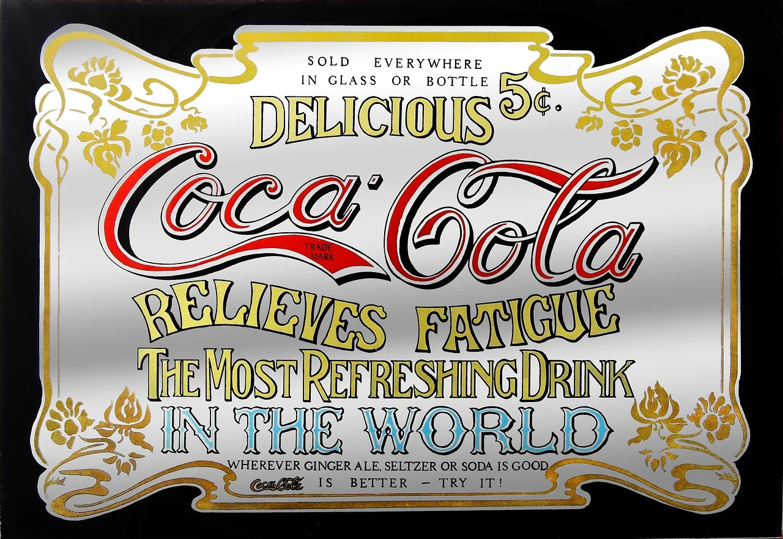
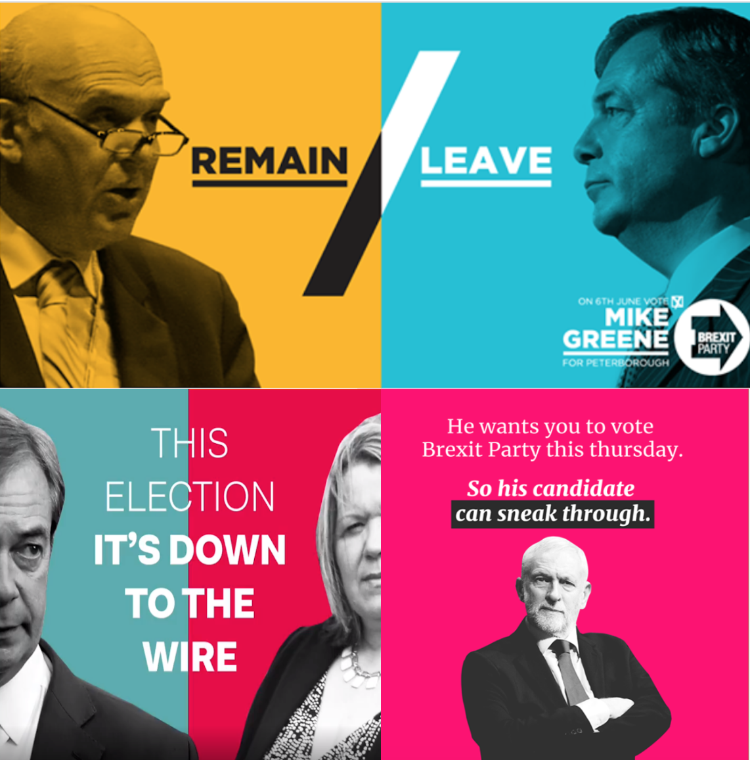
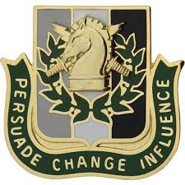
Existing Influencers
Friends, family etc
User experience designers
Advertisers
Political campaigns
Psyops, mis/disinfo etc

Slide 11
Session 1.2: Mechanisms
Disinformation/Malign Influence Training
SJ Terp & P Breuer, Threet Consulting | 2021

Slide 12
1.2 Mechanisms
Mechanisms
Example disinformation analyses.
Assessing social media misuse - channels, influencers, groups and messaging
An introduction to actors, behaviours, techniques, tools
The disinformation pyramid. Example incidents, example narratives.
Information operations as an information system
Human system vulnerabilities and psychology of influence
Cognitive biases and their abuses
The range of ways users and groups are influenced online (and offline via online means) - user experience, marketing and adtech, online political campaigns, astroturfing, online psyops, disinformation campaigns.
Common influence techniques.
Applying marketing models
The medium is the message: Content vs Context

Slide 13
Human vulnerabilities and psychology of influence

Slide 14
Bias
Systematic deviation
Doesn’t have to be malicious, or have negative effects on people
Example: people tend to be overconfident about their own driving ability
Other examples of bias?
People aren’t actually unpredictable; there are systematic ways that we are biased
Which is more dangerous, sharks or vending machines? Which one kills more people each year? Which one should you run away from?
Just because reasoning isn’t “rational” doesn’t mean it isn’t useful
Which is more likely, that you’ll get hacked by the Chinese military or that your information will be stolen by an Estonian credit card farm?

Slide 15
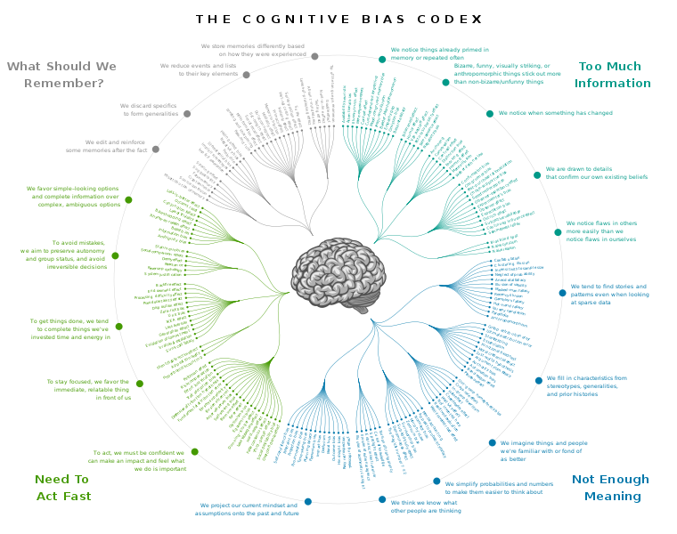
Cognitive Bias Codex
Chart of about 200 biases
Each of these is a vulnerability

Slide 16
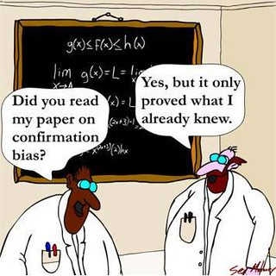
Confirmation bias
Believe what you want to believe
Desire >> facts
Notes:
https://www.psychologytoday.com/us/blog/science-choice/201504/what-is-confirmation-bias

Slide 17
Illusory truth bias
Believing something is true if it’s easy to understand, or repeated multiple times
Well hello, online advertising…
See also availability bias: Overestimating the likelihood or influence of things that are more visible / recent / emotionally charged (salience bias)
See also frequency illusion: noticing something more, once you’ve focussed on it (like seeing your make of car more once you’ve bought it)

Slide 18
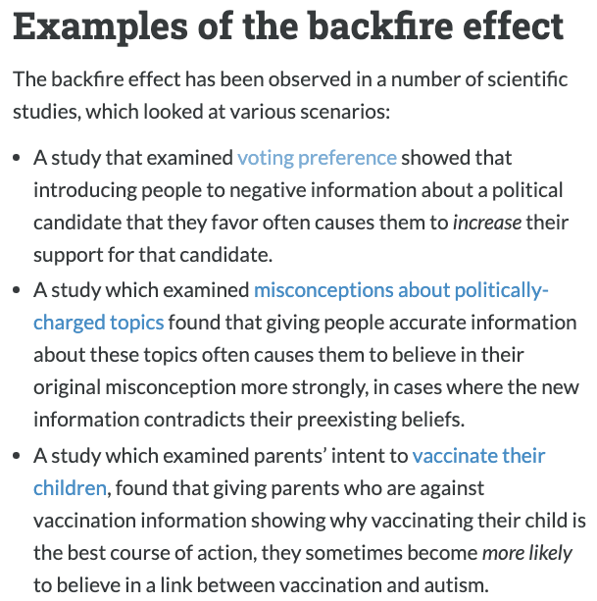
Familiarity backfire effect
Under dispute -
Doubling down on beliefs when they’re challenged
See also Semmelweis reflex: rejecting new contradicting evidence
Notes:
Image: https://effectiviology.com/backfire-effect-facts-dont-change-minds/

Slide 19
Human limits
“Good enough” (bounded rationality)
Cognitive limits (e.g. 7 +- 2)
Limited information
Emotion, trust, etc
Speed (thinking fast and slow)
System 1: automatic, low-effort, “knee-jerk” response
System 2: thoughtful choice between options

Slide 20
Information overload
Three Vs: too much information, too fast, too varied
Affect: emotional language = more likely to be shared
Messenger: trust people we know more
O’Reilly
People want more information than necessary to make a decision
Make worse decisions
Are more sure of decisions
Notes:
https://www.scientificamerican.com/article/biases-make-people-vulnerable-to-misinformation-spread-by-social-media/
https://link.springer.com/chapter/10.1007%2F978-3-642-22309-9_5

Slide 21
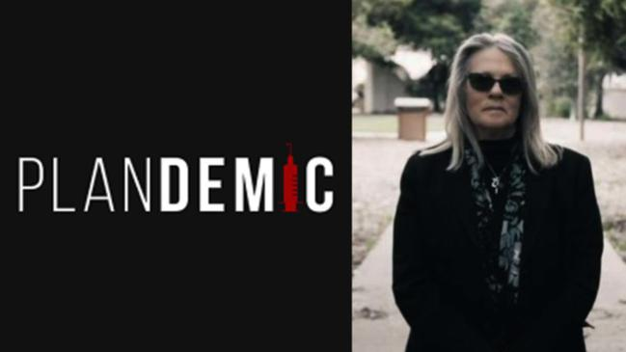
Trust and vulnerable communities
Trust boundaries
E.g. External low-trust, internal high-trust
See also: authority bias - believing authority figures more
Fake experts use these

Slide 22
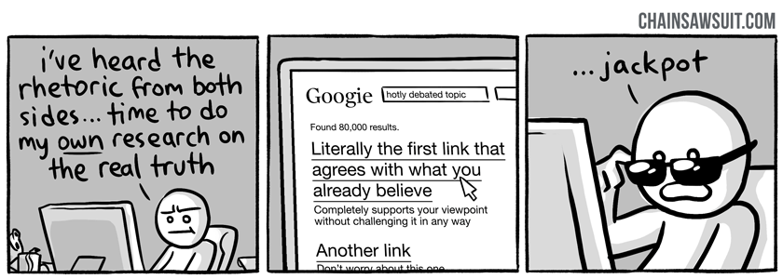
Online community biases
“Do your research”
Echo chambers: Different search terms, different profiles, give different results
Notes:
https://thinkingispower.com/the-problem-with-doing-your-own-research/

Slide 23
Algorithm biases
Filter bubbles: you’re training the algorithm on what you want to see
(Try searching in incognito mode… )
Homogeneity bias: platform uses small number of sources
Popularity bias: popular content != quality
Astroturfing etc use these
Notes:
Image: https://knowyourmeme.com/photos/923510-wikipedia

Slide 24
Learning from non-disinformation influencers

Slide 25
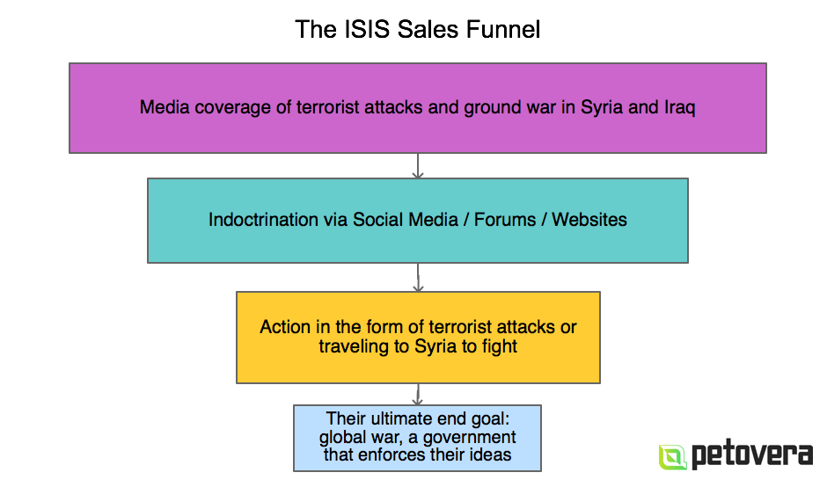
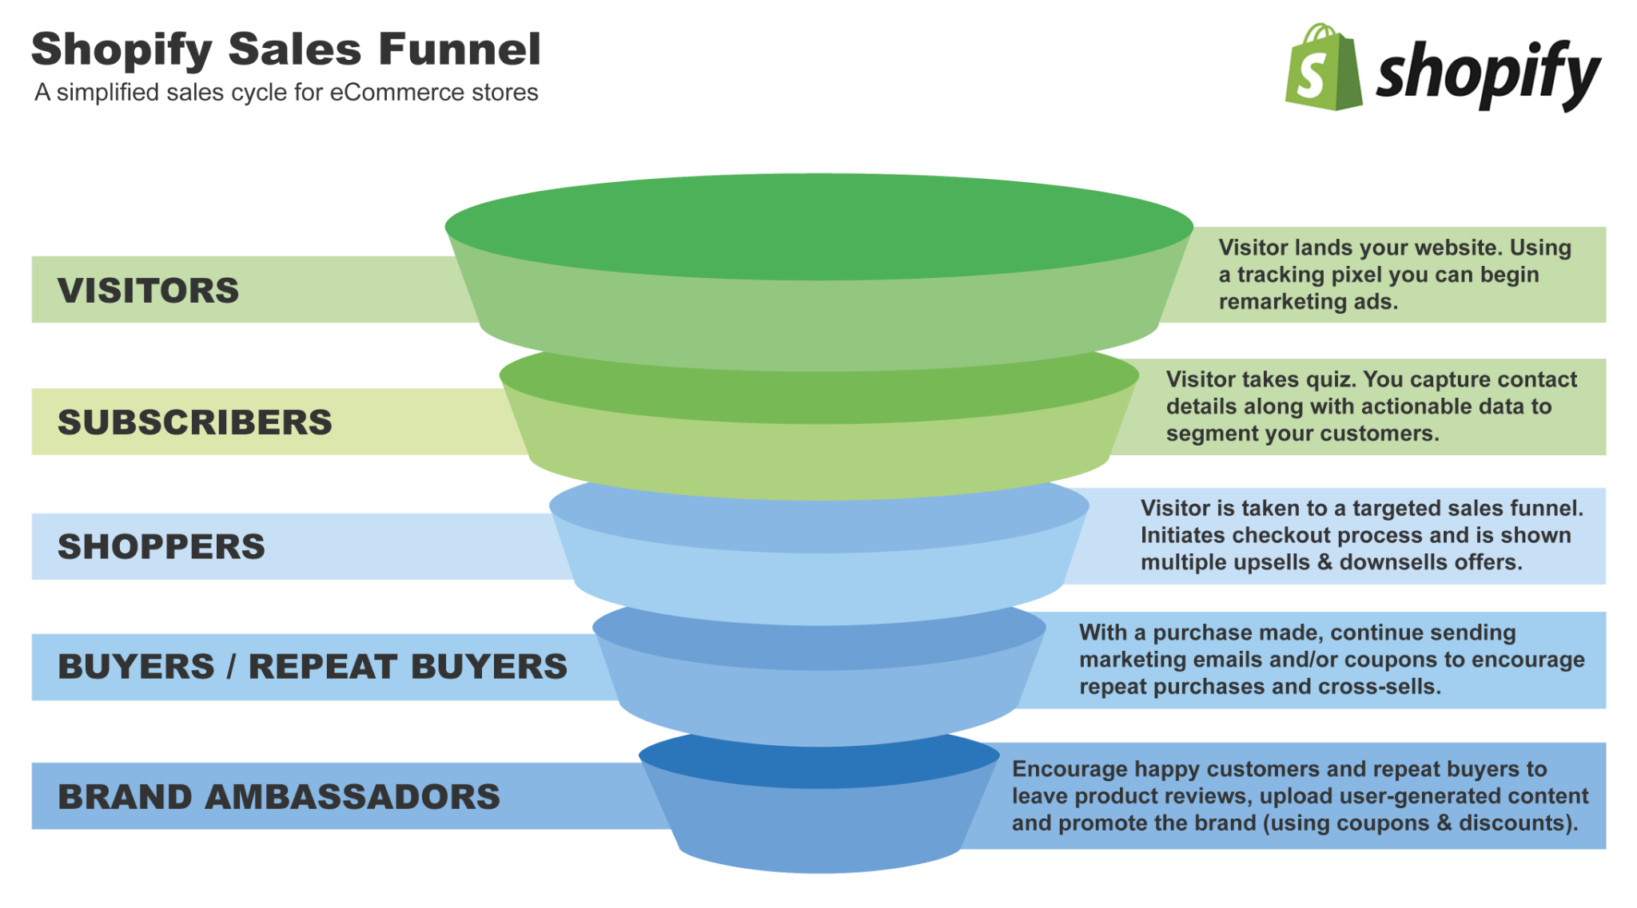
Marketing: sales funnels
Notes:
Image: https://revenuehunt.com/build-sales-funnel-shopify-store/
Image: https://www.autogrow.co/the-evil-isis-sales-funnel-deconstructed/

Slide 26
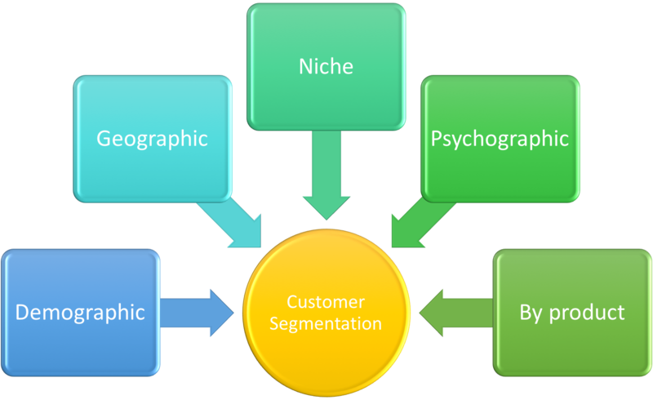
Marketing: Customer segmentation and targetting
Notes:
“Influence to me is being able to control what someone sees about you - which then leads to you being able to control what they think about you. So PR is organized truth” - Ulysses Osuna, Influencer Press
Links
https://www.forbes.com/sites/cognitiveworld/2019/10/04/the-art-of-online-influence/?sh=457a490847ef
https://www.ytcstudios.com/blog/2020/10/5/the-influence-of-fake-news-on-marketing
https://www.dictionary.com/browse/the-medium-is-the-message
Image: https://commons.wikimedia.org/wiki/File:Customer_Segmentation.png

Slide 27
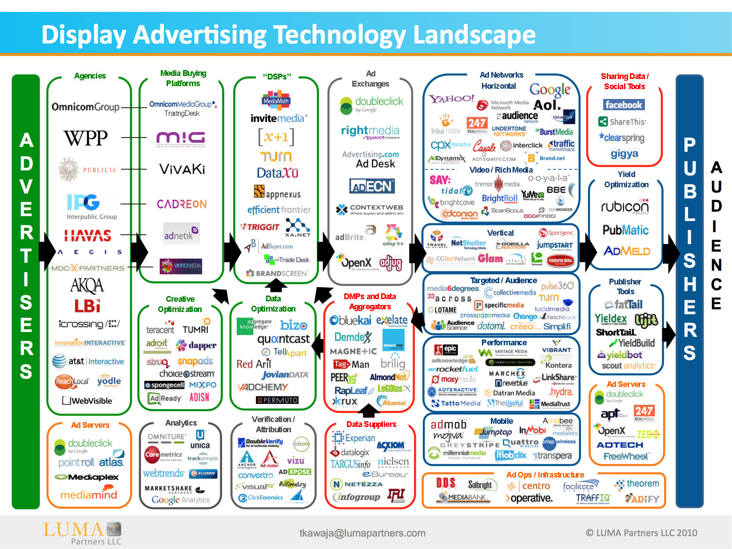
AdTech: microtargeting
Notes:
Image: https://www.adexchanger.com/venture-capital/ecosystem-map-luma-partners-kawaja/

Slide 28
Geopolitics: Information threats
Democracy
Require common political knowledge
Who the rulers are
Legitimacy of the rulers
How government works
Draw on contested political knowledge to solve problems
Vulnerable to attacks on common political knowledge
Autocracy
Actively suppress common political knowledge
Benefit from contested political knowledge
Vulnerable to attacks on the monopoly of common political knowledge
Notes:
https://www.schneier.com/blog/archives/2018/11/information_att.html

Slide 29
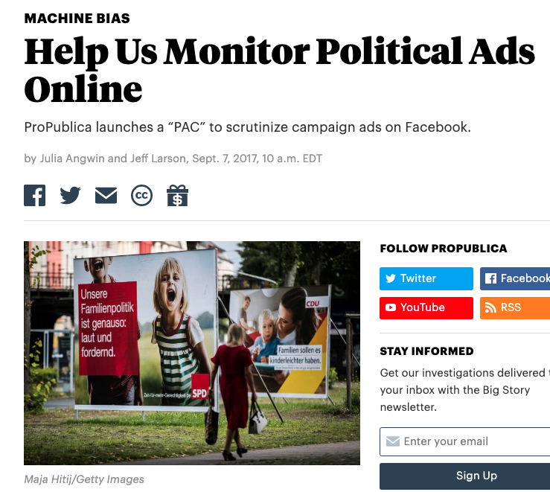
Politics: ad (non) transparency
Notes:
Image: https://www.pewresearch.org/fact-tank/2015/05/19/more-americans-are-using-social-media-to-connect-with-politicians/
https://www.facebook.com/ads/library

Slide 30
Psyops: Most cyberspace operations are based on influence
Force an adversary to make a decision or take an action based on:
Information I hide
Information I give
Information I change
Information I deny/degrade
Information I destroy
Enable my decisions based upon knowing yours
“Operations to convey selected information and indicators to audiences to influence their emotions, motives, and objectives reasoning, and ultimately the behavior of governments, organizations, groups, and individuals”

Slide 31
Influence: How

Slide 32
The medium is the message
McLuhan’s “The medium is the message”: the forms and methods used to communicate information have a significant impact on the messages they deliver (including meanings and perceptions”
“Never mind the content; what’s important is the medium… the media are extensions of our senses; as they change, they transform our environment and affect everything we do -- they “massage” or reshape us” - McLuhan

Slide 33
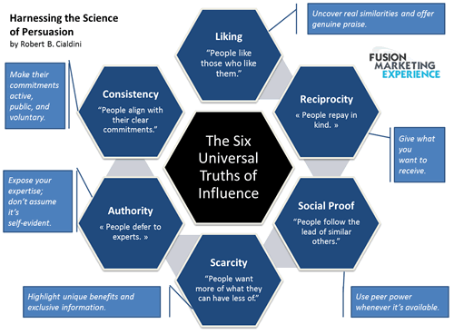
Using those biases

Slide 34
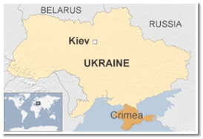
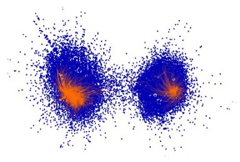
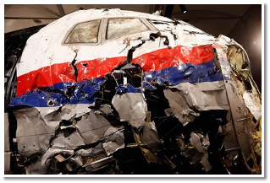
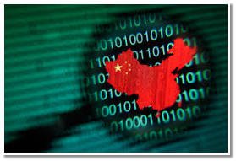
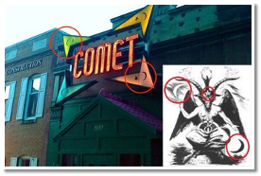
Mechanisms of Influence
Divide
Distort
Distract
Dismiss
Dismay
Notes:
The social strategies for mass population influence can be divided into five categories: Distort, Distract, Dismay, Dismiss, and Divide.
•Distort the facts. We’re not invading the Ukraine; we’re rescuing/protecting ethnic Russians.
•Distract from the main issue. MH-17 was a tragedy. Why is a commercial airliner flying over a war zone?
•Divide: Reduce trust, create confusion, and provoke populations. It’s not an accident when two groups at polar opposite ends of the political spectrum “magically” have competing events at the same time and place.
•Dismay: Ad-hominem – make personal attacks, insults and accusations. This one is particularly interesting because by even addressing these attacks, you lend them credence. Think about Pizzagate. Making a preposterous claim suggesting that political elites have a secret sex dungeon full of kids is very hard to defend against without lending the accusations credence.
•Dismiss: Critics and uncomfortable facts. Make counter-accusations. We’ve seen this one used often by China. Every time the U.S. accuses China of stealing our intellectual property via illicit hacking, China retorts by first dismissing the accusation and then stating that they’re the targets of U.S. hacking.
•
Reference: Nimmo, Ben. 19 May 2015. “Anatomy of an Info-War: How Russia’s Propaganda Machine Works, and How to Counter it.” StopFake.org 01 December 2018<https://www.stopfake.org/en/anatomy-of-an-info-war-how-russia-s-propaganda-machine-works-and-how-to-counter-it/>
Social graph: Dr. Kate Starbird, via https://twitter.com/katestarbird/status/954805298652332032

Slide 35
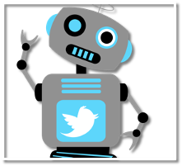
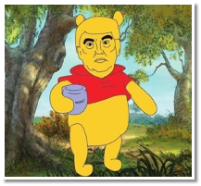
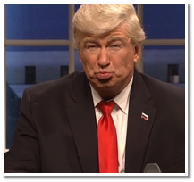
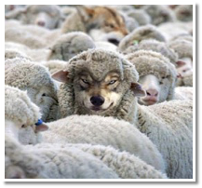
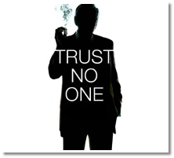
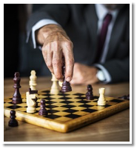
Mechanisms of Influence
Bots
Parody
Spoof
Camouflage
Deep cover
Takeover
Notes:
In order to implement those strategies using the power of social networks, we need accounts with access to social groups, and personas. These types of accounts can be broken into six categories.
Bots: Bulk purchase, mostly amplifiers, little-to-no original content
Parody: Clearly counterfeit account used to satirize or diminish image
Spoof: Counterfeit account which closely copies real account.
Camouflage: False account which mimic community of real accounts
Deep Cover: False account accepted as real for long periods of time
Takeover: Real account in control of adversary
It’s easy to get caught up in the technology: hacking accounts, identity theft, botnets, and so on, but it’s important to remember that the technology is only one aspect of the integrated problem space.
Reference:
https://medium.com/@timboucher/adversarial-social-media-tactics-e8e9857fede4

Slide 36

Network contagion
Notes:
Links
Image: https://commons.wikimedia.org/wiki/File:Social_Network_Analysis_Visualization.png
Paper to check out: https://www.pnas.org/content/106/51/21544

Slide 37
Disinformation as a service
“Doctor Zhivago’s services were priced very specifically, as seen below:
$15 for an article up to 1,000 characters
$8 for social media posts and commentary up to 1,000 characters
$10 for Russian to English translation up to 1,800 characters
$25 for other language translation up to 2,000 characters
$1,500 for SEO services to further promote social media posts and traditional media articles, with a time frame of 10 to 15 days
Raskolnikov, on the other hand, had less specific pricing:
$150 for Facebook and other social media accounts and content
$200 for LinkedIn accounts and content
$350–$550 per month for social media marketing
$45 for an article up to 1,000 characters
$65 to contact a media source directly to spread material
$100 per 10 comments for a given article or news story”
Notes:
From https://www.recordedfuture.com/disinformation-service-campaigns/
Since then, more ex marketing, spam etc companies have joined in, and actors from countries (using fake groups as cutouts) to individuals (to sway a court case) have used DAAS services.

